Slide 1
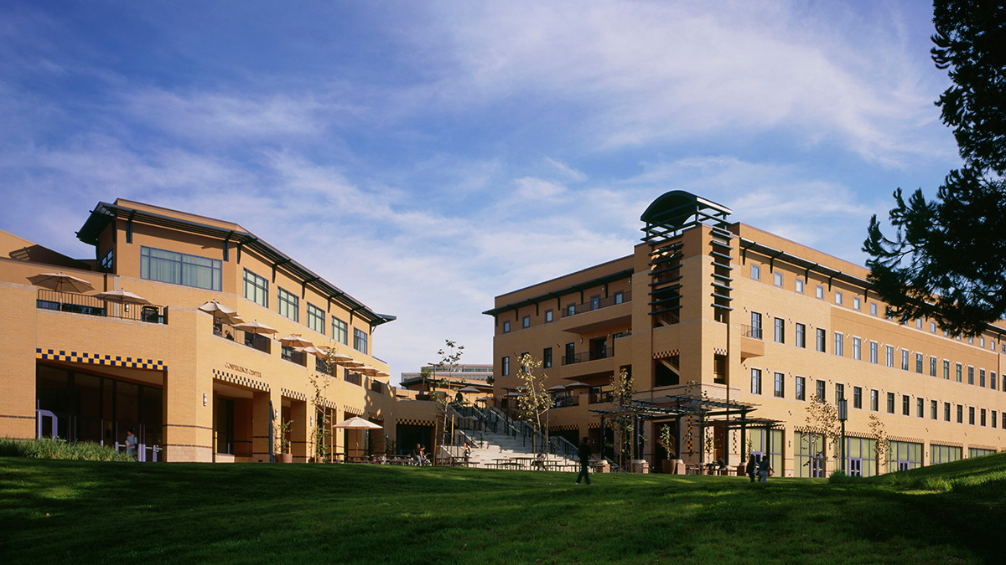
New Student Orientation
2017– 2018
http://engineering.uci.edu/admissions/undergraduate/newly-admitted
Click ‘2017 New Transfer Orientation’

Slide 2
Engineering Orientation Topics
UCI Academic Structure
Preparing for the Fall quarter
Registering for classes
Academic Requirements
School of Engineering overview
Academic Standards
Policies and Procedures
Study Schedule
Research and Project
Internship and Career Center

Slide 3
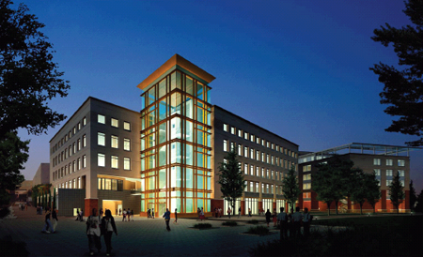
UCI Academic Structure
Arts
Biological Sciences
Business
Education
Engineering
Humanities
Information and Computer Sciences
Physical Sciences
Social Ecology
Social Sciences
Health Sciences

Slide 4

Important Offices & Departments
Admissions
Financial Aid
Registrar
Housing
Learning & Academic Resource Center
Counseling Center
Career Services
Parking
Disability Services
Student Health

Slide 5

Before Fall Quarter Classes Start….
Check out the New Student Handbook
  http://www.newstudents.uci.edu/
Get your UC photo ID card at The Hill in Student Center
  http://www.thehill.uci.edu
Update address with Registrar’s Office
Complete your Statement of Legal Residence
Enroll in classes using WebReg

Slide 6

Health Insurance
Students are automatically enrolled in USHIP
Students can “waive out” of the plan if they can demonstrate they have comparable coverage
  Must apply online to waive out before Sep 1st.
  http://www.shc.uci.edu/Health_Insurance_Privacy/USHIP-StudentHealthCenter-UCI.aspx
  Waive out as early as possible, do not wait till the last day.
  Complete details available at Student Health Center at: www.shc.uci.edu
Notes:
Explain that’ student pay a fee for Health Insurance but can avoid the fee by demonstrating comparable coverage.

Slide 7
Paying tuition and fees
Fee Deadline: Sep. 15th, 4:30 p.m.
If you have Financial Aid…
  Aid is applied to fees automatically once you enroll in 6 minimum required units (MRU’s)
  Must enroll in 6 MRU’s by fee deadline
If you do not have Financial Aid…
  Pay ZOTBill online
  https://zotaccount.uci.edu/
  Contact the Registrar Office if you have questions. 949-824-6124
  View deadlines on Registrar’s Calendar
  https://www.reg.uci.edu/calendars/quarterly/2016-2017/quarterly16-17.html
Notes:
Explain courses will be dropped if payment is not made on time. Deadline is NOT postmark deadline.

Slide 8

VETERAN SERVICES
Are you a dependent of a Veteran? If so, you may be entitled to free tuition. Please visit the UCI
Veteran’s Service office on campus!
If you’re a dependent using VA benefits or Cal Vet
fee wavier the veteran services office can process the paperwork for you.
Veteran’s Professional Fraternity
The mission of the veterans fraternity is to provide a social and professional space for veterans who are transitioning from military service to academia.
Contact veteransuci@gmail.com
University of California, Irvine Veteran Services Center
G304 Student Center Irvine, CA 92697-5125
(949) 824-3500 phone
(949) 824-7971 fax
http://www.veteran.uci.edu veteran@uci.edu

Slide 9
You should have already…
Sent ALL transcripts to Admissions
Due Date: July 1st
Contact Admissions Office for questions about transcripts and Admission conditions
myadmissionsapplication@uci.edu
Notes:
AP scores: need to request that ALL years be sent (e.g. if student took 2 AP tests in Junior year, then 2 in Senior year--need to request BOTH years.
Remind student of DUE DATE--a registration HOLD will result if deadline missed. (admissions will remind students via e-mail.

Slide 10
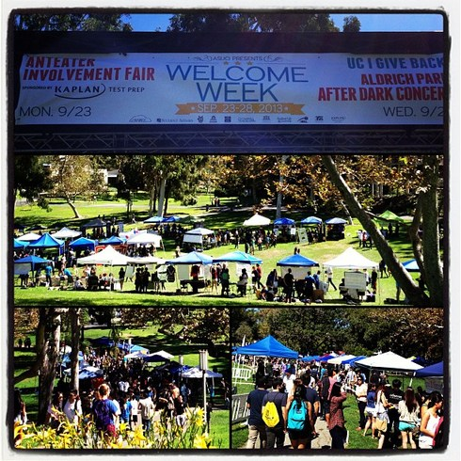
Welcome Week
Sept 25– Sept 27
http://search.dos.uci.edu/welcomeweek/
New Student Convocation
  Monday, Sept 25, 9:15 a.m. at Bren Events Center
  Dean’s Welcome
  Anteater Club Fair in Aldrich Park

Slide 11
Instruction begins
Thursday, Sept 28, 2017
Labs and Discussions will start after the
first lecture class.

Slide 12
Registering For Classes in fall 2017
When to enroll
After attending the Engineering Transfer Orientation, your hold will be lifted. You may enroll in classes on the orientation day.
Check course schedule on WebSOC
http://websoc.reg.uci.edu/perl/WebSoc
Enroll in classes through WebREG
Access WebReg Video Tutorial:
http://www.reg.uci.edu/registrar/soc/webreg.html

Slide 13
Enrollment in WebReg
Log on using UCInetID and password
You may enroll 18 units for now.
18-unit enrollment limit (undergrad) will be
lifted at noon on Sept 1.
See Academic Calendar
http://reg.uci.edu/calendars/quarterly/2017-2018/quarterly17-18.html
Notes:
Priority: Campuswide Honors Program and Athletics
Adjustment Period: The restrictions will be lifted. Some students who did not pay the fee will be dropped. Some courses are full may
have open spaces at this time. The student on the waiting list will be automatically enrolled. It is important you
place yourself on the waiting list.

Slide 14
Enrollment after Fall quarter
Use WebReg or StudentAccess to view your enrollment window at the seventh week
Each student has an initial 48 hour priority window to enroll classes via WebReg
After the priority window is passed, enrollment via WebReg is available 7pm - 7am daily

Slide 15
Enrollment Tips
Enroll as soon as your window opens!!
  Enrollment window starts at the eighth week.
  If the class is full, use waitlists when available.
  If you took the prerequisites from colleges or universities other than UCI, you will need the prerequisite clearance.
  For fall 2017, your classes were cleared by your counselor.
Check frequently for course changes and/or cancellations
Notes:
Some courses may cancelled, EECS 140 is cancelled this fall and will be offered in spring 2006. Some courses may change time or location.

Slide 16
Enrollment Tips (cont’d)
Refer to the finals schedule to prevent overload during finals week
Refer to COMMENTS in WebSOC for additional enrollment information. For example, policy for repeats, the date of lifting restrictions, add/drop/change deadlines, etc.
http://websoc.reg.uci.edu/perl/WebSoc
http://plaza.eng.uci.edu
Registration HOLDs
  If you have a hold, contact the office that placed the hold on your record for resolution
Notes:
Explain how “comments” section in WebSOC details any course limitations/restrictions.
Go to www.uci.edu and search for final exam schedule.

Slide 17
Academic Requirements
Incoming transfer students follow 2016-2017 catalog for Academic Requirements
http://catalogue.uci.edu/

Slide 18

B.S. DEGREE
University Requirements
UC Irvine Requirements
General Education Requirements
Major Requirements

Slide 19
University of California Requirements
Entry Level Writing Requirement
American History and Institutions
Notes:
Transfer students with IGETC may not meet the requirement for American History and Institutions, please check your UCI transcript after fall 2005. If you have further questions, please ask your counselor.

Slide 20
IGETC
If you have IGETC or partial IGETC, you do not need to follow UCI general education.
Submit the IGETC certificate or Partial IGETC certificate to your counselor in fall quarter.
IGETC or partial IGETC is certified by your college counselor, not by UCI counselor.
You need to complete UC requirements (American History & Institution) and upper division writing even you have completed IGETC.
Notes:
Fulfilling IGETC does not necessarily mean that your University Requirements have also been completed. Check with counselor if you are in doubt.

Slide 21
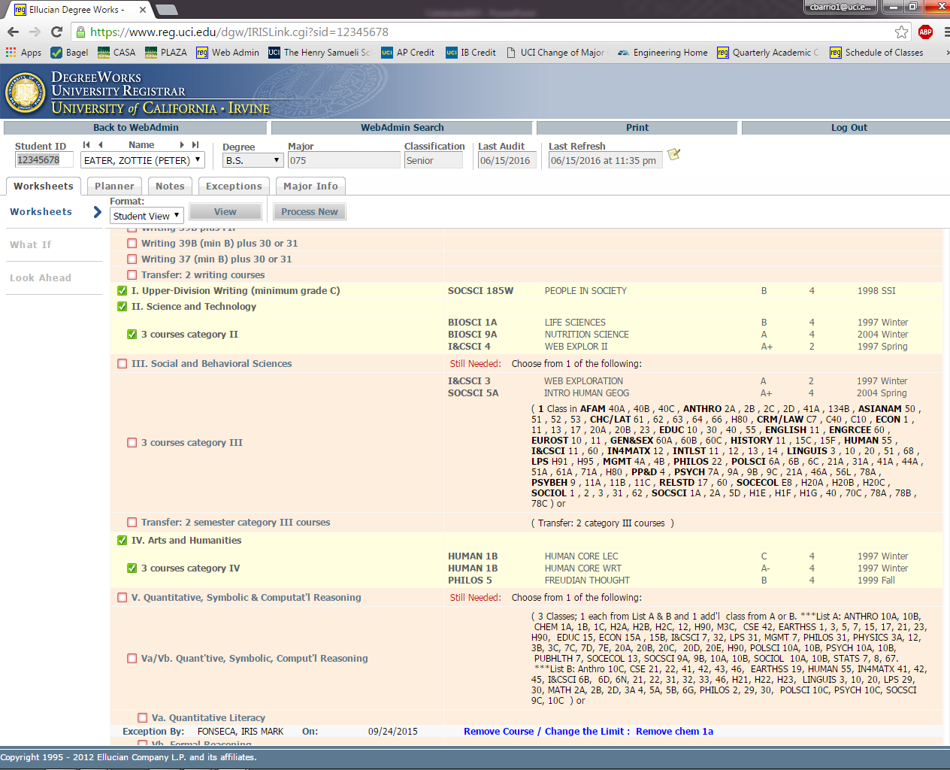

Slide 22
HSSoE Majors
Aerospace
Biomedical*
Biomedical: premed
Chemical
Civil
Computer Engineering
Computer Science and Engineering (CSE)**
Electrical
Environmental
Materials Science*
Mechanical
Two minors are offered in Biomedical Engineering and Materials Science Engineering
*minor is offered
**joint program w/ICS
Notes:
We have five departments and 11 majors.
Change of major within the department will be considered, but change of major outside of your departments will not be approved.
Talk to your counselor if you have questions.

Slide 23
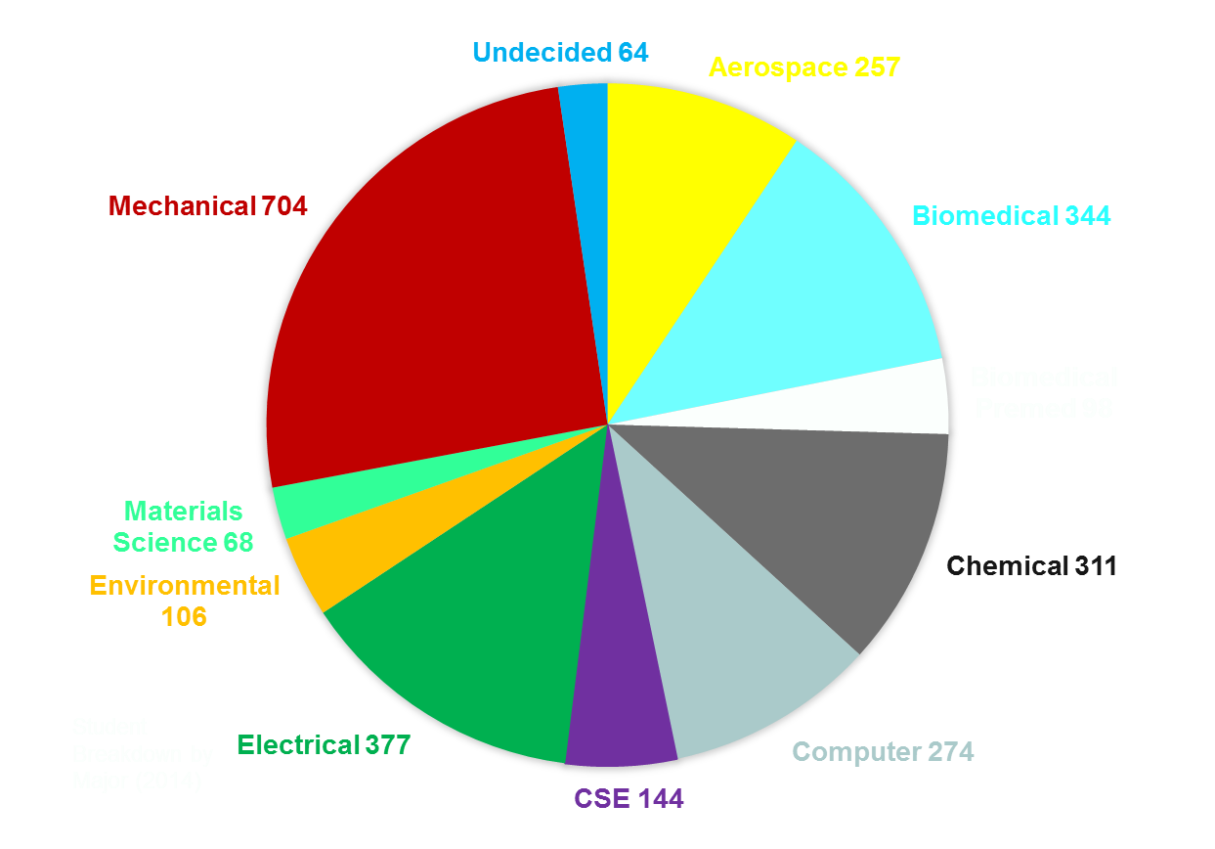

Slide 24
Get involved
In addition to your academic program, you are encouraged to involve
with the following activities if time is permitted.
Research (199 course) and Project courses
Internship
http://www.career.uci.edu/
Student organization
http://www.asuci.uci.edu/
http://www.eng.uci.edu/current/undergraduate/clubs-and-organizations
Notes:
Tell students that they will be more attractive to employers or Grad School when they have experiences like internships, research, and other activities to “round out” their education. Be a competitive candidate.

Slide 25

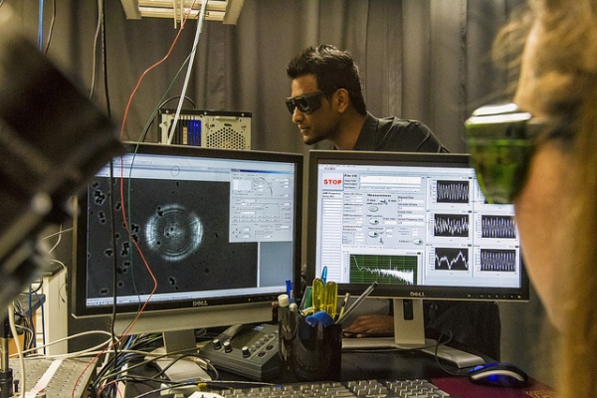
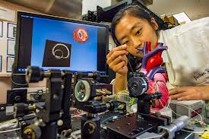
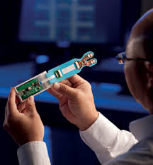
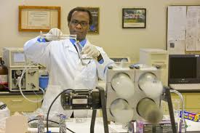
Examples of Research Areas
  Beckman Laser Institute
  Edwards Lifesciences Center
National Fuel Cell Center
Urban Water Resource Ctr.
Cal Institute for Tele Tech
(Calit2)

Slide 26
How to enroll in research
Learn more about the research interests of the faculty http://www.eng.uci.edu/
Contact the professor/faculty.
Print the Proposal form of Individual Study from undergraduate.eng.uci.edu website under Forms.
Bring the approved form from the professor back to Engineering Student Affairs office to be authorized for enrollment.
For EE and Computer Engineering majors, 3.0 GPA is required to apply for
research.

Slide 27



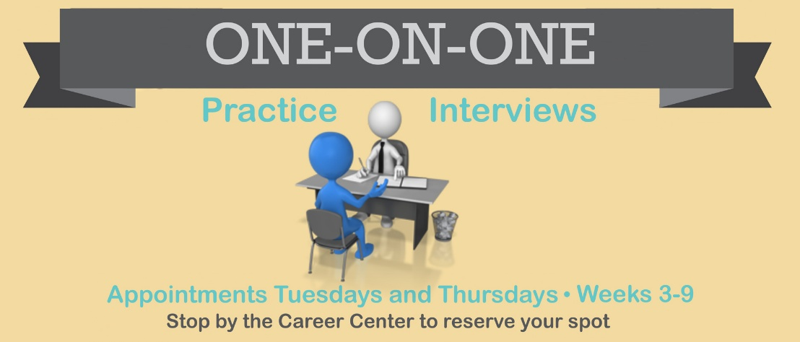
Career Center
Job Search Strategies
Resume Writing Workshops
Interview Techniques
Career Fair
  Oct. 19, 2017 STEM Fair
  Oct. 26, 2017 Fall Career Fair
  Jan. 25, 2018 Internship Career Fair
  EngiTECH Career Fair (TBA)

Slide 28
Engineers Week
Four-day events to promote interaction and communication among engineering students, faculty, alumni and industry.
E-Week activities:
Dean’s breakfast, Competitions, and Award Banquet
EngiTECH Career Fair

Slide 29
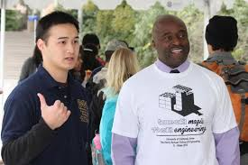
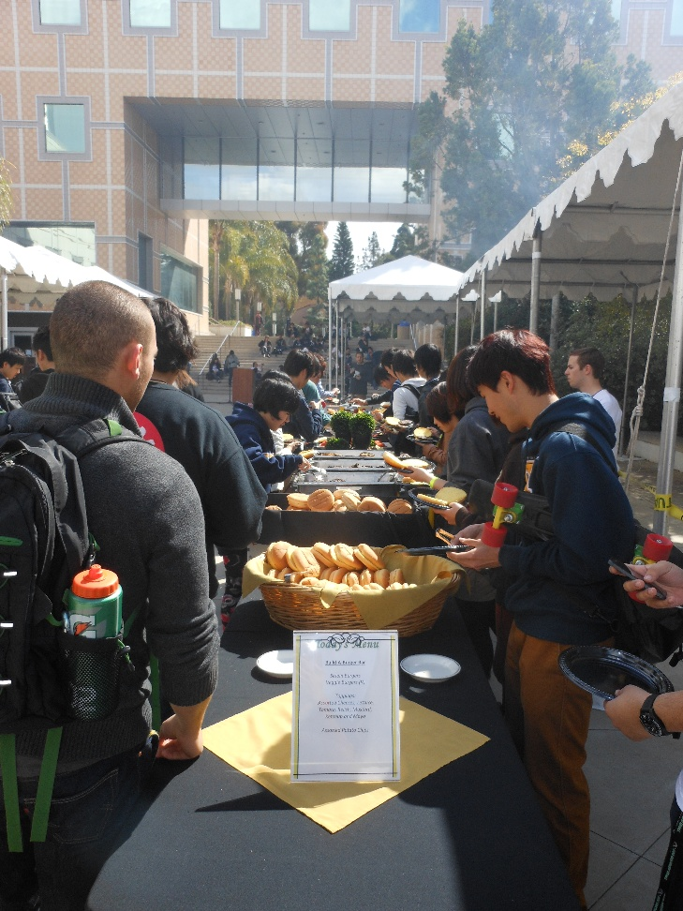
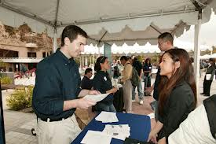
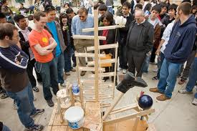
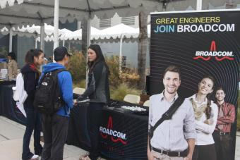
E-Week
Career Fair & Activities

Slide 30

All policies and procedures are strictly enforced

Slide 31
Catalogue Rights
Students enrolled at UCI from their freshman year may elect to meet as graduation requirements
  Those requirements in effect at the time of entrance; or
  Those subsequently established catalog year
Complete policy in catalogue
2017 incoming transfers select 2016-2017 catalog year http://catalogue.uci.edu/

Slide 32
University of California Policy Confidentiality
By law, the Engineering Student Affairs Office and other UCI officials may not release any student information to ANYONE without written consent from the student.

Slide 33
Confidentiality continued…
What does this policy mean to you?
Students MUST be the point of contact with any campus official
Information that CANNOT be released:
  Grades
  Class Schedule
  Academic status
Release form for engineering students
The above information will not be released unless you
sign the Release Form.

Slide 34
Add/Drop/Change Deadlines for Engineering courses
ADDING and DROPPING a course
  Friday of the 2nd week of the quarter
Change of grade option
  Friday of the 6th week of the quarter
  No grade change will be allowed after 6th week
Any requests after these deadlines need to petition online through Enrollment Exception on Student Access. If you have hardship, please petition early. Do not wait till the 6th week. Approval will be granted only under extenuating circumstances .
Notes:
Engineering is very strict. Explain different deadlines may exist for different academic units; MATH and SCIENCE courses need to abide by ENGR timelines. --refer to packet for details. All major courses (incl. Math and Science) must be taken for a letter grade. Petition approval NOT automatic--subject to review by that academic unit. Poor academic performance is an insufficient reason for a post-deadline change.

Slide 35
Grades
Letter Grades: A, B, C, D, F
  All Engineering, Math, Physics and Chemistry courses and any courses required for the major must be taken for a letter grade.
  If you do not fail the class (F grade), you pass the course. However some courses have graded prerequisites (need C or C- for the prerequisites). Refer to the catalog for details.
Pass/Not Pass Grades: P or NP
  Does not affect GPA
  General education courses can be taken Pass/Not Pass
  C or better will be Pass (P), C- or lower grade will be Not Pass (NP)

Slide 36
Repeating Classes
  You may repeat courses only when grades of C-,D+,D, D-,F, or NP were received, otherwise an UR (Unauthorized Repeat) notation will be posted on your transcript.
  Up to 16 unit of repeats can be replaced for GPA. Every repeat counts towards the 16 units regardless the same course or not.
  Following that, course grades are averaged (both grades counts for GPA)

Slide 37
More about Repeats
The consequence of repeating a class and earn ‘F’ grade.
The F grade counts for GPA.
You need to repeat the class again,
even you had C- to D- grade before.

Slide 38
Academic Standards
Normal Progress
Students that fail to make normal progress will be placed on academic probation or may be subject to disqualification.
Notes:
Have students refer to packet--go over this policy very carefully and ensure student FULLY understand it. Ask students for questions, etc.

Slide 39
Not making Normal Progress
lower division Writing Requirement needs to be completed ASAP.
Failure to complete 12 units in any given quarter
Failure to maintain a 2.0 GPA in
  All coursework
  All Engineering coursework
  All upper division Engineering coursework
Notes:
Need to be full-time, unless part-time study petition is approved.

Slide 40
Academic Probation (AP)
Academic Probation
  GPA below 2.0 (quarterly, cumulatively, in ENGR courses or in upper division ENGR courses)
Subject to Disqualification
  GPA below 2.0 for 2 consecutive quarters
  GPA below 1.5 for any quarter
The 1.5 Rule (for transfer student)
  Quarterly GPA below 1.5 or on AP for 2 consecutive quarters during the 1st year may be subject to exit from the School of Engineering

Slide 41
Academic Honesty
Be academically honest
Consequences can range from
  a failing grade
  dismissal from the University
Complete policy listed in Catalogue
Notes:
See handout in packet.

Slide 42

Strategies For Success
Treat school as a full-time job
Go to office hours to ask questions, do not get behind.
Be realistic about the amount of work you can get done in a given period.
Study 3 hours per week for any one unit you enroll.
Notes:
Access site. MUST SIGN-IN to show how to use online petitions/forms.

Slide 43
Academic Framework
Engineering coursework is built upon a foundation of math and science.
Interdependency of knowledge
  prerequisites and corequisites required
Emphasis on retaining knowledge
Study to learn, not to pass the class.

Slide 44

Be on top of your degree
It is your responsibility to be on top of your degree requirements and graduate in time.
Transfer student has to graduate within three years.
Follow Program of Study.
See counselor or email counselor for any assistance.
Meeting with an Academic Counselor at least once a year
is strongly recommended.

Slide 45
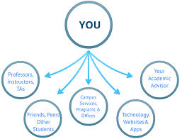
Academic Resources
Faculty and T.A office hours
Engineering tutoring (OAI)
Departmental Tutoring

Slide 46
Office of Access & Inclusion (OAI)
  Free one-on-one tutoring located in REC 201
  Academic and career skills Workshops
  Professional Development Workshops
  Mentoring Programs
Internship and job shadowing opportunities
Industry and alumni networking socials
Diversity student organizations
  http://tech.uci.edu/access/faq.php
Notes:
SWITCH: transition to Christy

Slide 47
Undergrad Student Affairs
Contacting the Office
  Telephone: (949) 824-4334
Location
  Rockwell Engineering Center REC 305 (311 on UCI map)
Office Hours
  Monday - Friday
  8:30 a.m. - 12:00 p.m. &
  1:00 p.m. - 4:30 p.m.
Call Engineering Student Affairs Office to schedule appointments
Notes:
Information is also in Student Handbook.

Slide 48
Undergraduate Engineering website
http://undergraduate.eng.uci.edu/
RESOURCES
(technical electives, teaching plan, double count GE courses, study abroad, etc.)
FORMS
(course authorization, excess unit petition, course review, etc.)
http://www.eng.uci.edu/
Undergraduate Study
Graduate Study
Research
Directory

Slide 49
Counselors for Undergraduate Student Affairs Office
Cesar Barrios (CBARRIO1@UCI.EDU)
Christy King (CLKING@UCI.EDU)
Meei-jiuan Shyu (MSHYU@UCI.EDU)
Mitzi Orme (MITZI.ORME@UCI.EDU)
Ushma Patel (UPATEL@UCI.EDU)
Arianna Warner (A.WARNER@UCI.EDU)

Slide 50

Individual Advising
Make an appointment to see your counselor in fall quarter 2017 or winter 2018
Mark your calendar to call our office after October
1, 2017. Call 949-824-4334 to schedule a one hour
appointment for new transfers.
Bring IGETC or Partial IGETC certificate to the appointment.
DegreeWorks will be updated. Full program of study will be discussed.

Slide 51
Faculty Advising
All students are required to attend Faculty Advising* session once a year
  done by faculty
  required for accreditation
You will get email notification regarding the date and time from your department
Failure to attend will result in a hold for following term enrollment
* Faculty Advising is not the same as meeting your academic counselors.

Slide 52
Website for enrolling in classes
You may find links of the following website from
http://www.reg.uci.edu
Schedule of Classes
WebReg (register for classes)
Student Access (You can view your unofficial transcripts,
DegreeWorks, course eligibilities, apply graduation, change of major
and enrollment exceptions)
Antplanner
  https://antplanner.appspot.com/
Video Tutorial
http://www.reg.uci.edu/registrar/soc/webreg.html
Notes:
Use Anteater, Peter The #12345678 for DEMO Or use Video Tutorial

Slide 53
Course Eligibilities
Most classes have prerequisites.
If you completed the prerequisites from colleges or universities other than UCI, you will need the prerequisite clearance to enroll.
For fall 2017, all your classes are cleared for enrollment.
You may need to petition for prerequisite clearance to enroll after fall 2017.
Check the Course Eligibilities at Student Access before petition.

Slide 54
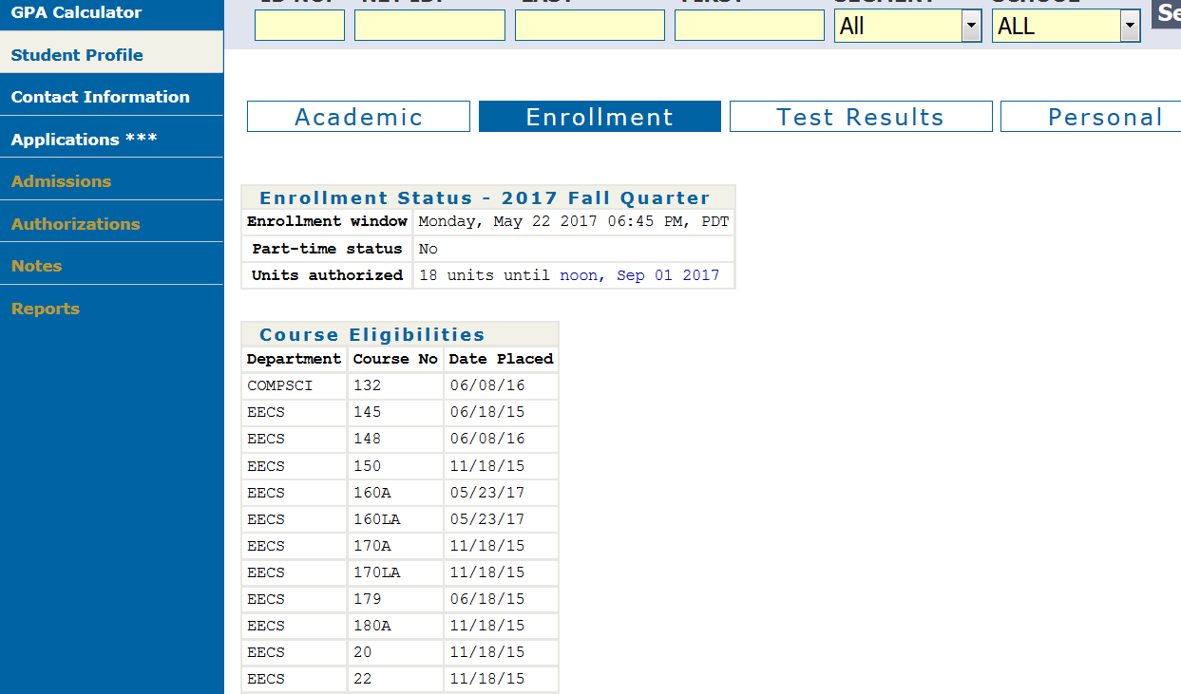
Student Access→Student Profile→ Enrollment

Slide 55
How to petition
Go to http://undergraduate.eng.uci.edu
Click ‘FORMS’
Course Authorization Submit Online

Slide 56
Admission Condition
If you have admission conditions and did not meet your conditions, your admission may be revoked.
Please contact your admission counselor regarding your admission status as soon as possible.

Slide 57
Software & Laptop
HSSOE website for software & laptop information:
http://laptops.eng.uci.edu/
View the “Laptops - Start Here” checklist:
http://laptops.eng.uci.edu/instructional-computing/laptop-start-here
If you have further questions, please contact lab manager, Lisa Preble.
http://laptops.eng.uci.edu/contact

Slide 58
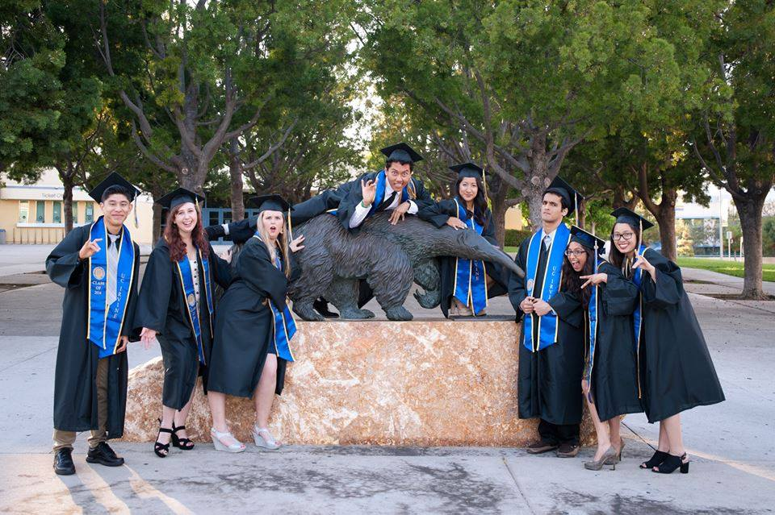
Welcome to UCI and the Samueli School of Engineering!
See you in fall quarter!

